Slide 1
The AETHERA Trial: Results of a Randomized, Double-Blind, Placebo-Controlled Phase III Study of Brentuximab Vedotin in the Treatment of Patients at Risk of Hodgkin Lymphoma Progression Following Autologous Stem Cell Transplant
Abstract #673
Moskowitz CH, Nademanee A, Masszi T, Agura E, Holowiecki J, Abidi MH, Chen AI, Stiff P, Gianni AM, Carella A, Osmanov D, Bachanova V, Sweetenham J, Sureda A, Huebner D, Larsen EK, Hunder NN, and Walewski J

Slide 2
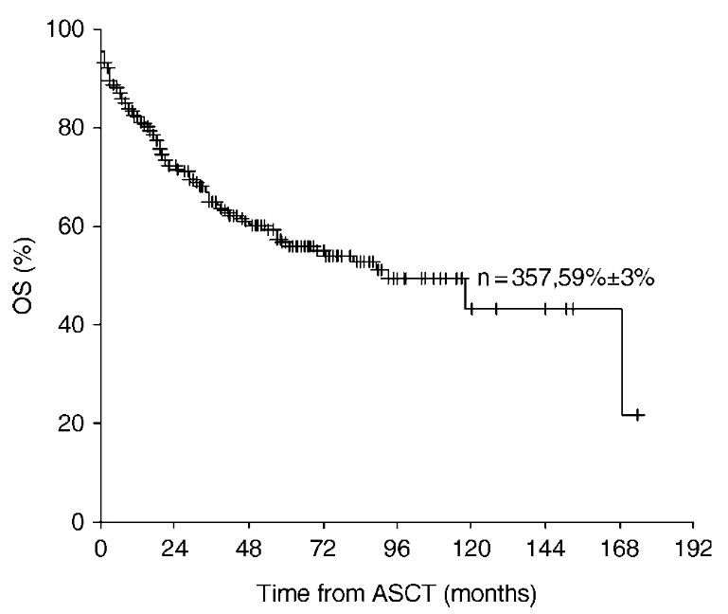
Background
Autologous stem cell transplant (ASCT) in patients with relapsed or refractory Hodgkin lymphoma (HL) can achieve cure in approximately 50% of patients^{a-d}
Over the past 20 years, no improvement has been shown in efficacy outcomes from randomized trials of ASCT regimens for aggressive lymphomas (HL or diffuse large B-cell lymphoma)
Brentuximab vedotin (ADCETRIS®; BV) is a CD30-directed therapy that has shown efficacy in patients with HL who relapsed or were refractory after prior ASCT^{e}
We conducted a randomized, placebo-controlled, phase 3 study to assess whether BV consolidation could prevent disease progression post-ASCT in patients at risk for relapse or progression
Prognostic factors affecting long-term outcome after stem cell transplantation in Hodgkin’s lymphoma autografted after a first relapse.ª
a. Sureda A, et al. Ann Oncol. 2005 ;16(4):625-633. b. Majhail NS, et al. Biol Blood Marrow Transplant. 2006;12: 1065. c. Sirohi B, et al. Ann Oncol. 2008;19:1312-1329. d. Hahn T, et al. Biol Blood Marrow Transplant. 2013;19:1740-1744. e. Younes A, et al. J Clin Oncol. 2012, 30: 2183-2189.
Moskowitz CH, et al. Blood. 2014;124: Abstract 673.

Slide 3
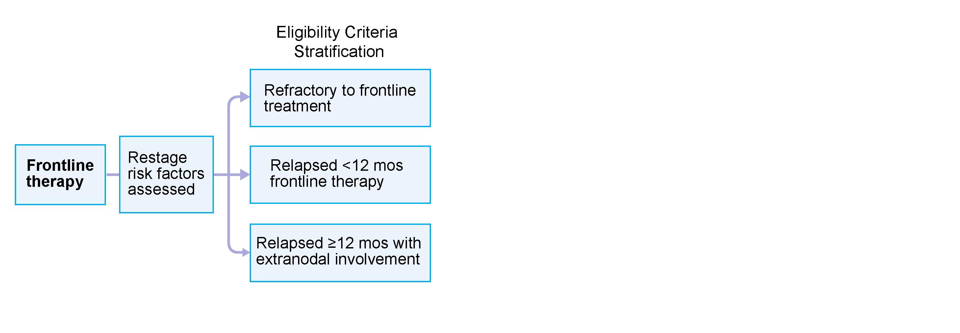
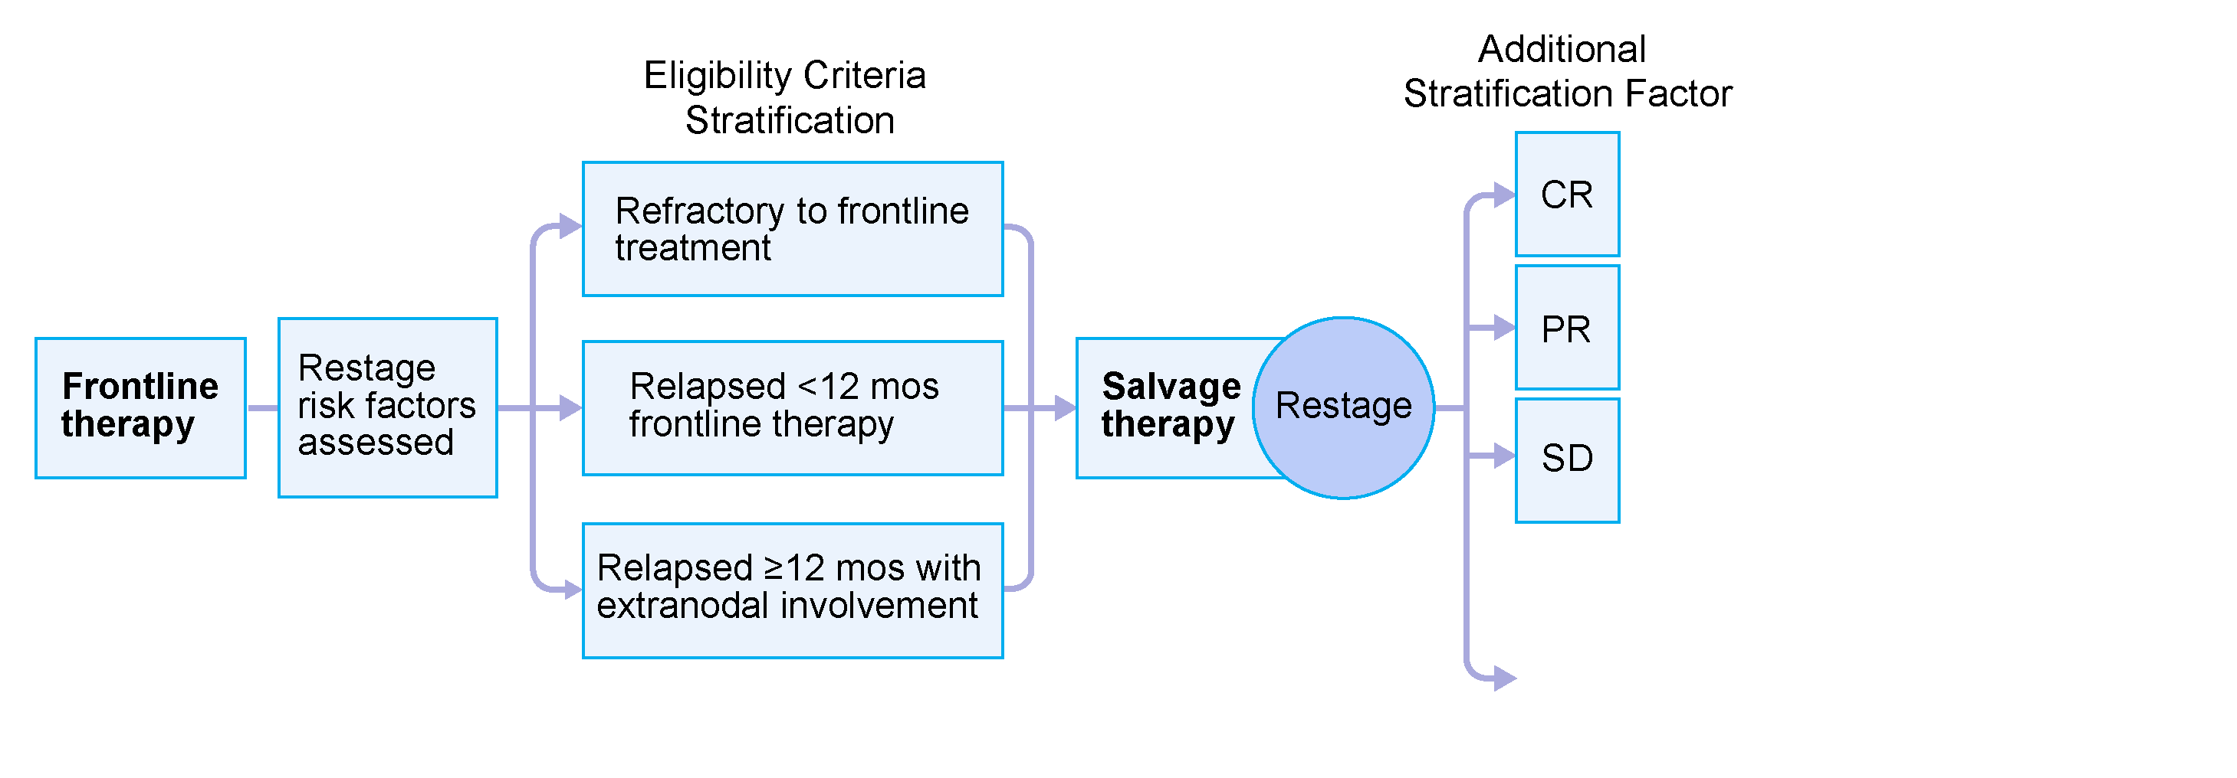
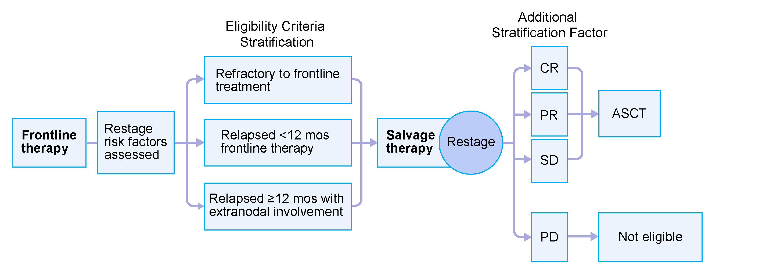
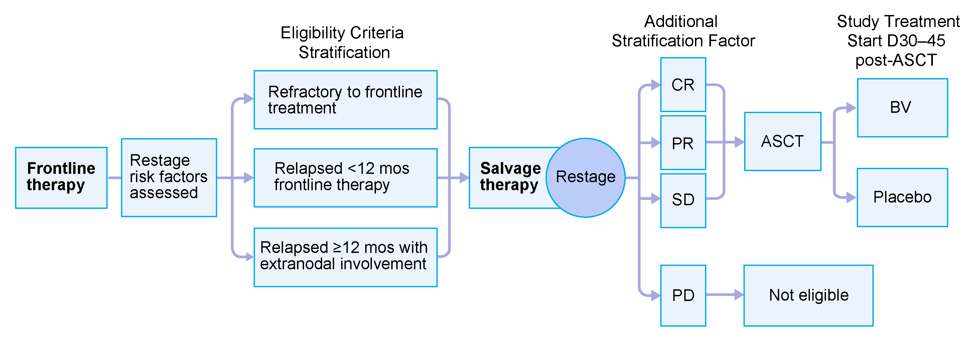
Study Design and Key Eligibility Criteria
329 patients were randomized at 78 sites in North America and Europe
Moskowitz CH, et al. Blood. 2014;124: Abstract 673.

Slide 4
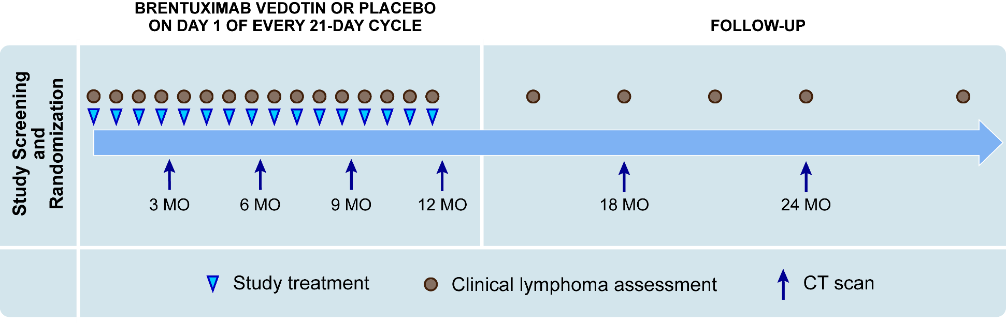
Treatment and Assessment Schedule
Patients were randomized to receive 16 cycles of BV or placebo
They were evaluated and treated every 21 days
Imaging quarterly for first year, then at 18 and 24 months
Importantly, patients who progressed on the placebo arm could subsequently receive BV on another trial
Moskowitz CH, et al. Blood. 2014;124: Abstract 673.

Slide 5
Main Objectives
Primary
To compare progression-free survival (PFS) per independent review facility (IRF) between the 2 treatment arms
Secondary
To compare overall survival (OS) between the 2 treatment arms
To evaluate the safety and tolerability of BV compared to placebo
Moskowitz CH, et al. Blood. 2014;124: Abstract 673.

Slide 6
Patient Characteristics
 | BV (N = 165) | Placebo (N = 164)
Age, years; median (range) | 33 (18-71) | 32 (18-76)
Gender | 46% M / 54% F | 59% M / 41% F
No. prior cancer-related systemic salvage therapies
1 | 94 (57) | 86 (52)
≥2 | 71 (43) | 78 (48)
HL status after frontline therapy
Refractory | 99 (60) | 97 (59)
Relapse <12 months | 52 (32) | 54 (33)
Relapse ≥12 months | 13 (8) | 13 (8)
Response with salvage therapy pre-ASCT
Complete remission | 61 (37) | 62 (38)
Partial remission | 57 (35) | 56 (34)
Stable disease | 47 (28) | 46 (28)
Extranodal involvement at pre-ASCT relapse | 54 (33) | 53 (32)
B symptoms after frontline therapy | 47 (28) | 40 (24)
Pre-ASCT PET status
FDG avid | 64 (39) | 51 (31)
FDG negative | 56 (34) | 57 (35)
Not available | 45 (27) | 56 (34)
Moskowitz CH, et al. Blood. 2014;124: Abstract 673.

Slide 7
Patient Disposition
Reason for treatment discontinuation | BV (N = 165) n (%) | Placebo (N = 164) n (%)
Completed treatment | 78 (47) | 81 (49)
Progressive disease | 24 (15) | 69 (42)
Adverse event | 54 (33) | 10 (6)
Patient decision | 9 (5) | 4 (2)
*All patients are off treatment
Moskowitz CH, et al. Blood. 2014;124: Abstract 673.

Slide 8
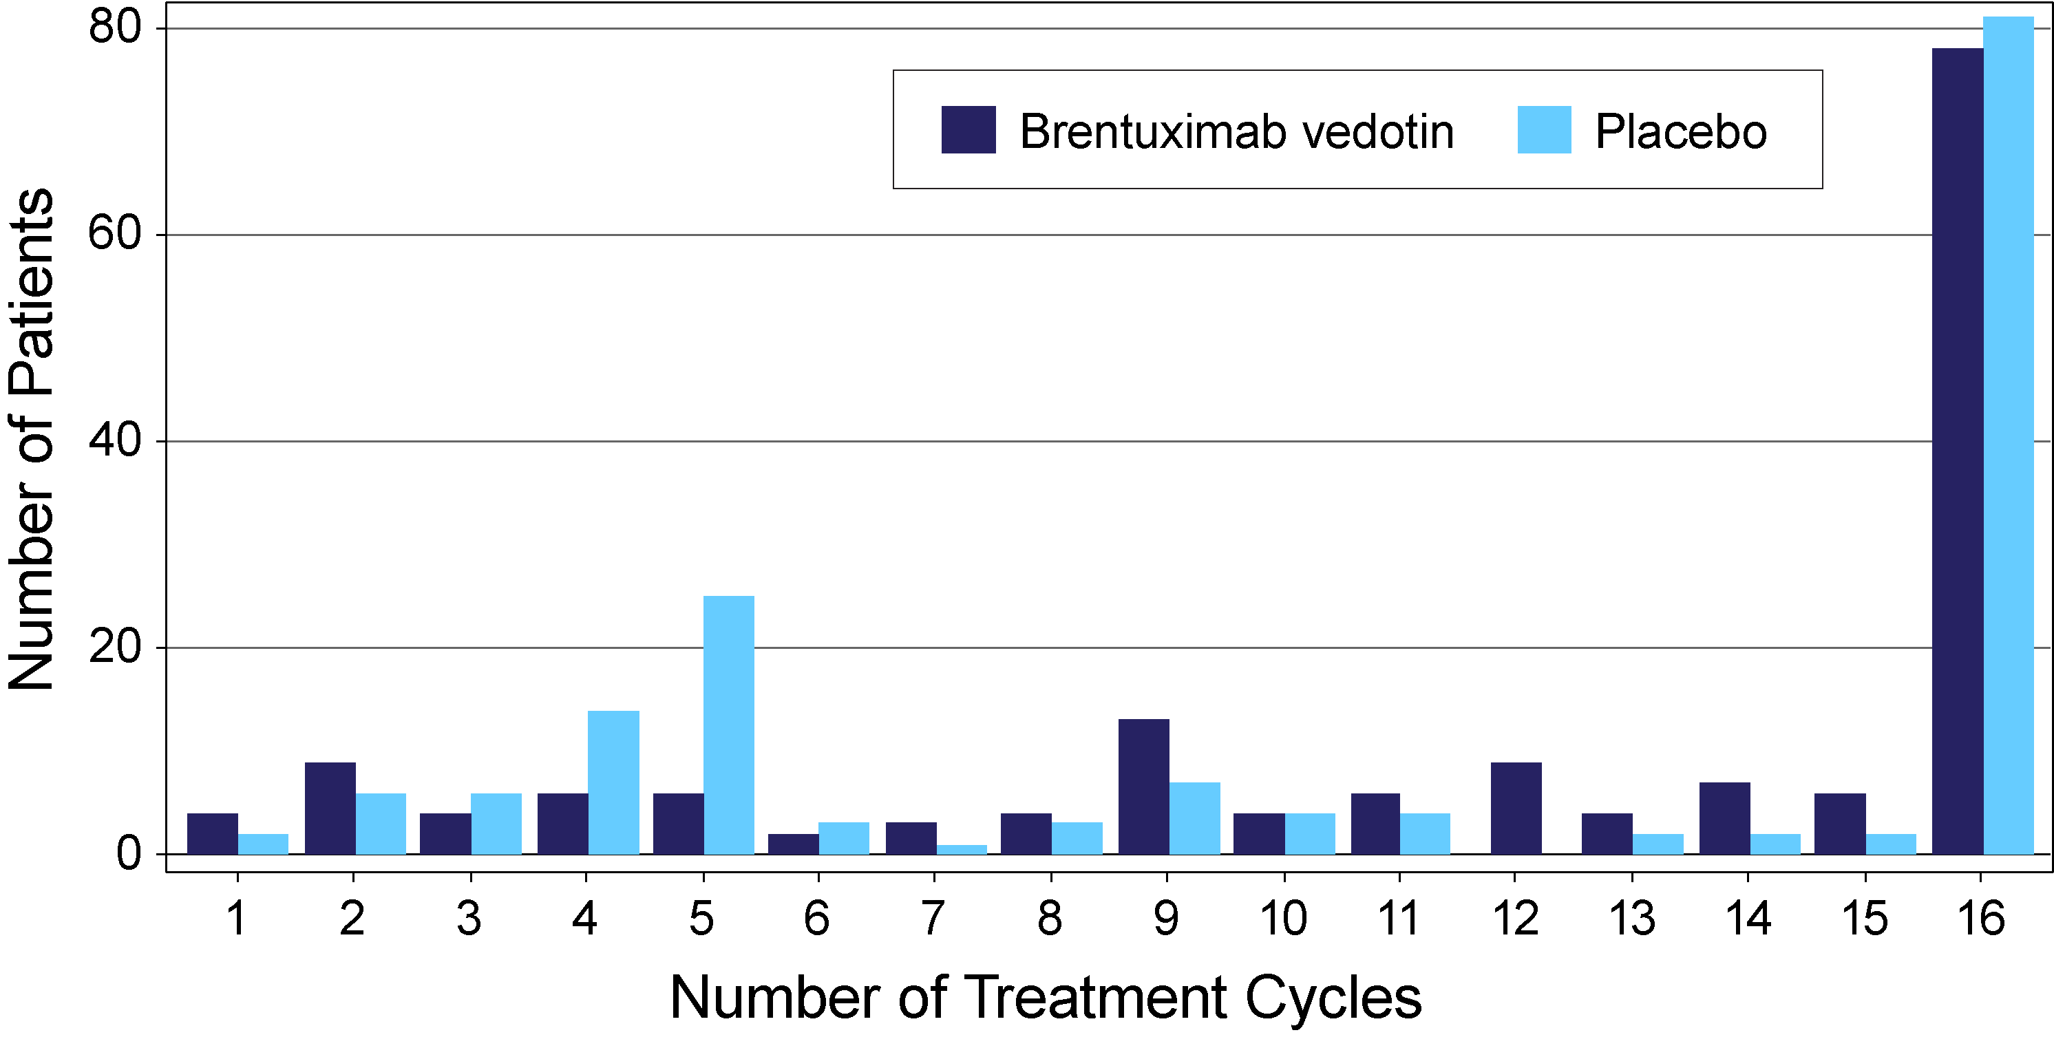
Patient Exposure
Median number of treatment cycles 15 in both arms
Mean number of treatment cycles: 12 BV, 11 placebo
Moskowitz CH, et al. Blood. 2014;124: Abstract 673.

Slide 9
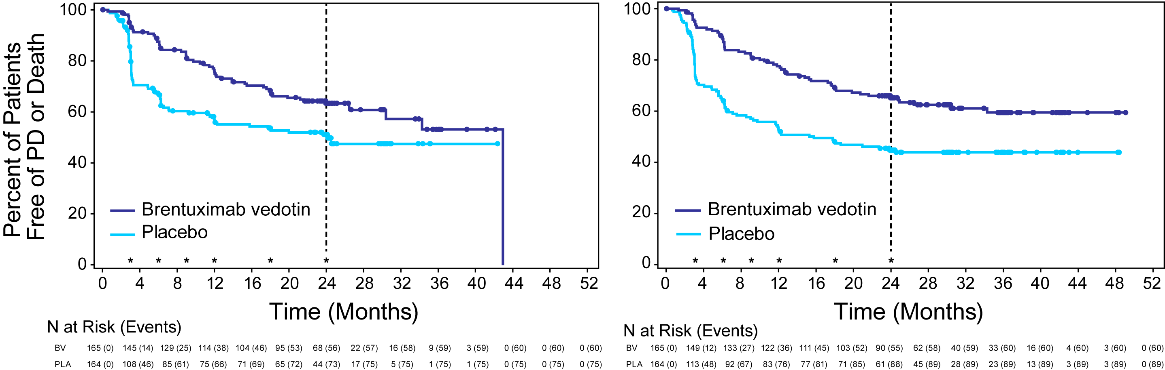
Progression-Free Survival
PFS per IRF
PFS per Investigator†
 | BV (N = 165) | Placebo (N = 164)
Hazard Ratio (95% CI) | 0.57 (0.40–0.81, P = .001)
Events | 60 | 75
Median PFS (months) | 43 | 24
2-year PFS rate | 63% | 51%
 | BV (N = 165) | Placebo (N = 164)
Hazard Ratio (95% CI) | 0.50 (0.36–0.70)
Events | 60 | 89
Median PFS (months) | -- | 16
2-year PFS rate | 65% | 45%
* Regularly scheduled CT scans
† Includes information from both radiographic assessments and clinical lymphoma assessments
Moskowitz CH, et al. Blood. 2014;124: Abstract 673.

Slide 10
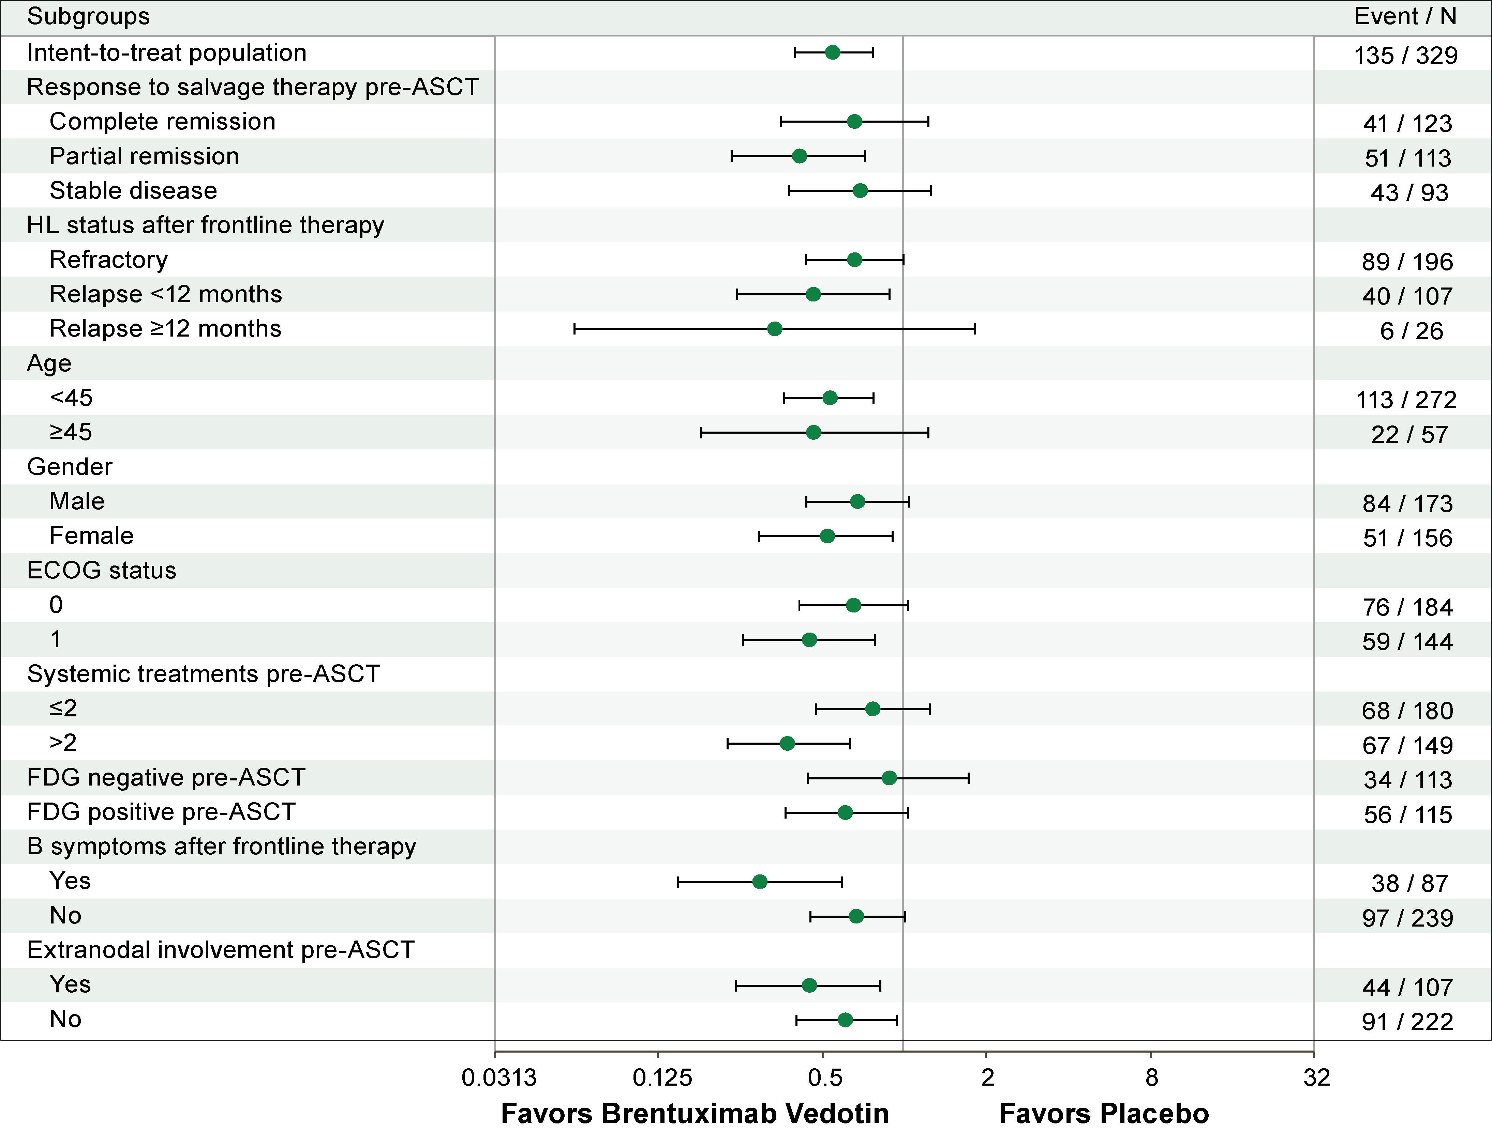
Subgroup Analysis of PFS per IRF
Moskowitz CH, et al. Blood. 2014;124: Abstract 673.

Slide 11
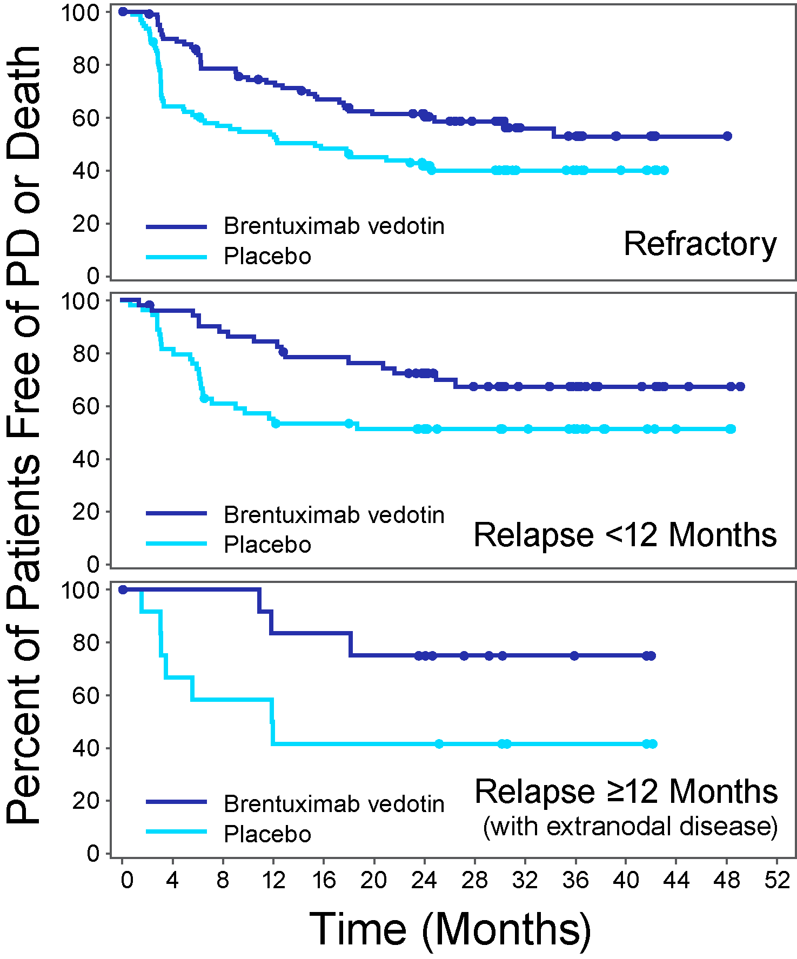
PFS* by Eligibility Criteria
N = 196
N = 107
N = 26
*Per investigator analysis
Moskowitz CH, et al. Blood. 2014;124: Abstract 673.

Slide 12
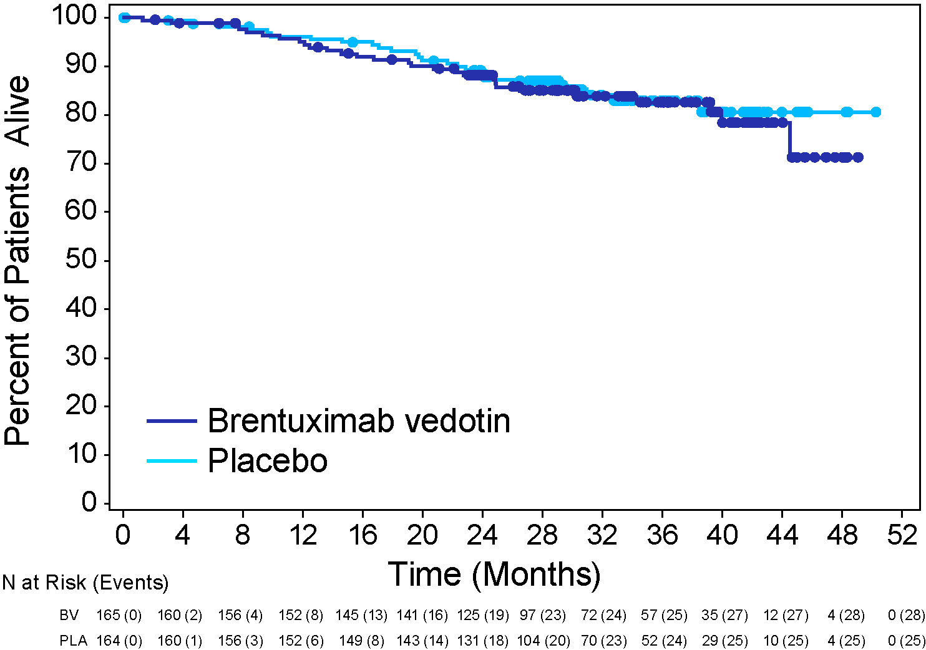
Overall Survival
Risk Factors
Relapsed <12 months or refractory to frontline therapy
Best response of PR or SD to most recent salvage therapy
Extranodal disease at pre-ASCT relapse
B symptoms at pre-ASCT relapse
Two or more prior salvage therapies
P=0.62
No. risk factors | N | PFS per IRF HR (95% CI) | OS HR (95% CI)
≥1 | 329 | 0.57 (0.40-0.81) | 1.15 (0.67-1.97)
≥2* | 280 | 0.49 (0.34-0.71) | 0.94 (0.53-1.67)
≥3* | 166 | 0.43 (0.27-0.68) | 0.92 (0.45-1.88)
* Ad hoc analysis
Moskowitz CH, et al. Blood. 2014;124: Abstract 673.

Slide 13
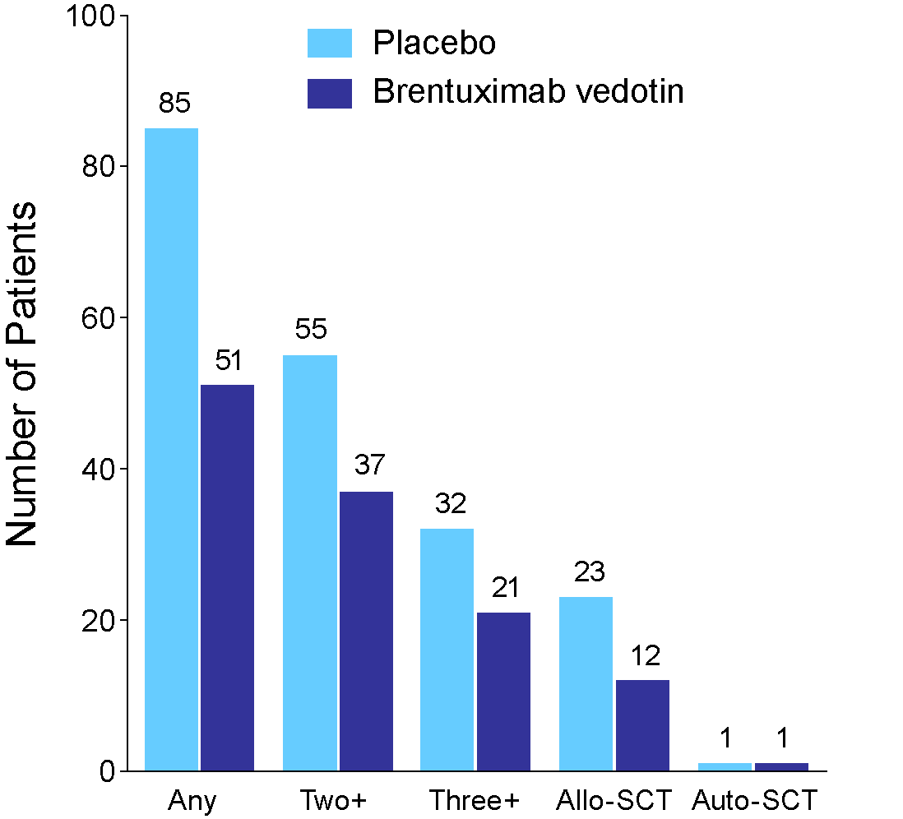
Subsequent Anti-tumor Therapies
Patients who received subsequent anti-tumor therapy
 | BV (N = 51) n (%) | Placebo (N = 85) n (%)
Single-agent BV | 8 (16) | 72 (85)
Multi-agent regimen including BV | 1 (2) | 1 (1)
Stem cell transplant* | 13 (25) | 24 (28)
Multi-agent chemotherapy | 35 (69) | 34 (40)
Radiation | 22 (43) | 23 (27)
Single-agent chemotherapy | 22 (43) | 22 (26)
Donor lymphocyte infusion | 2 (4) | 1 (1)
Other treatment | 1 (2) | 2 (2)
* Most were allogeneic (12 BV, 23 placebo)
Moskowitz CH, et al. Blood. 2014;124: Abstract 673.

Slide 14
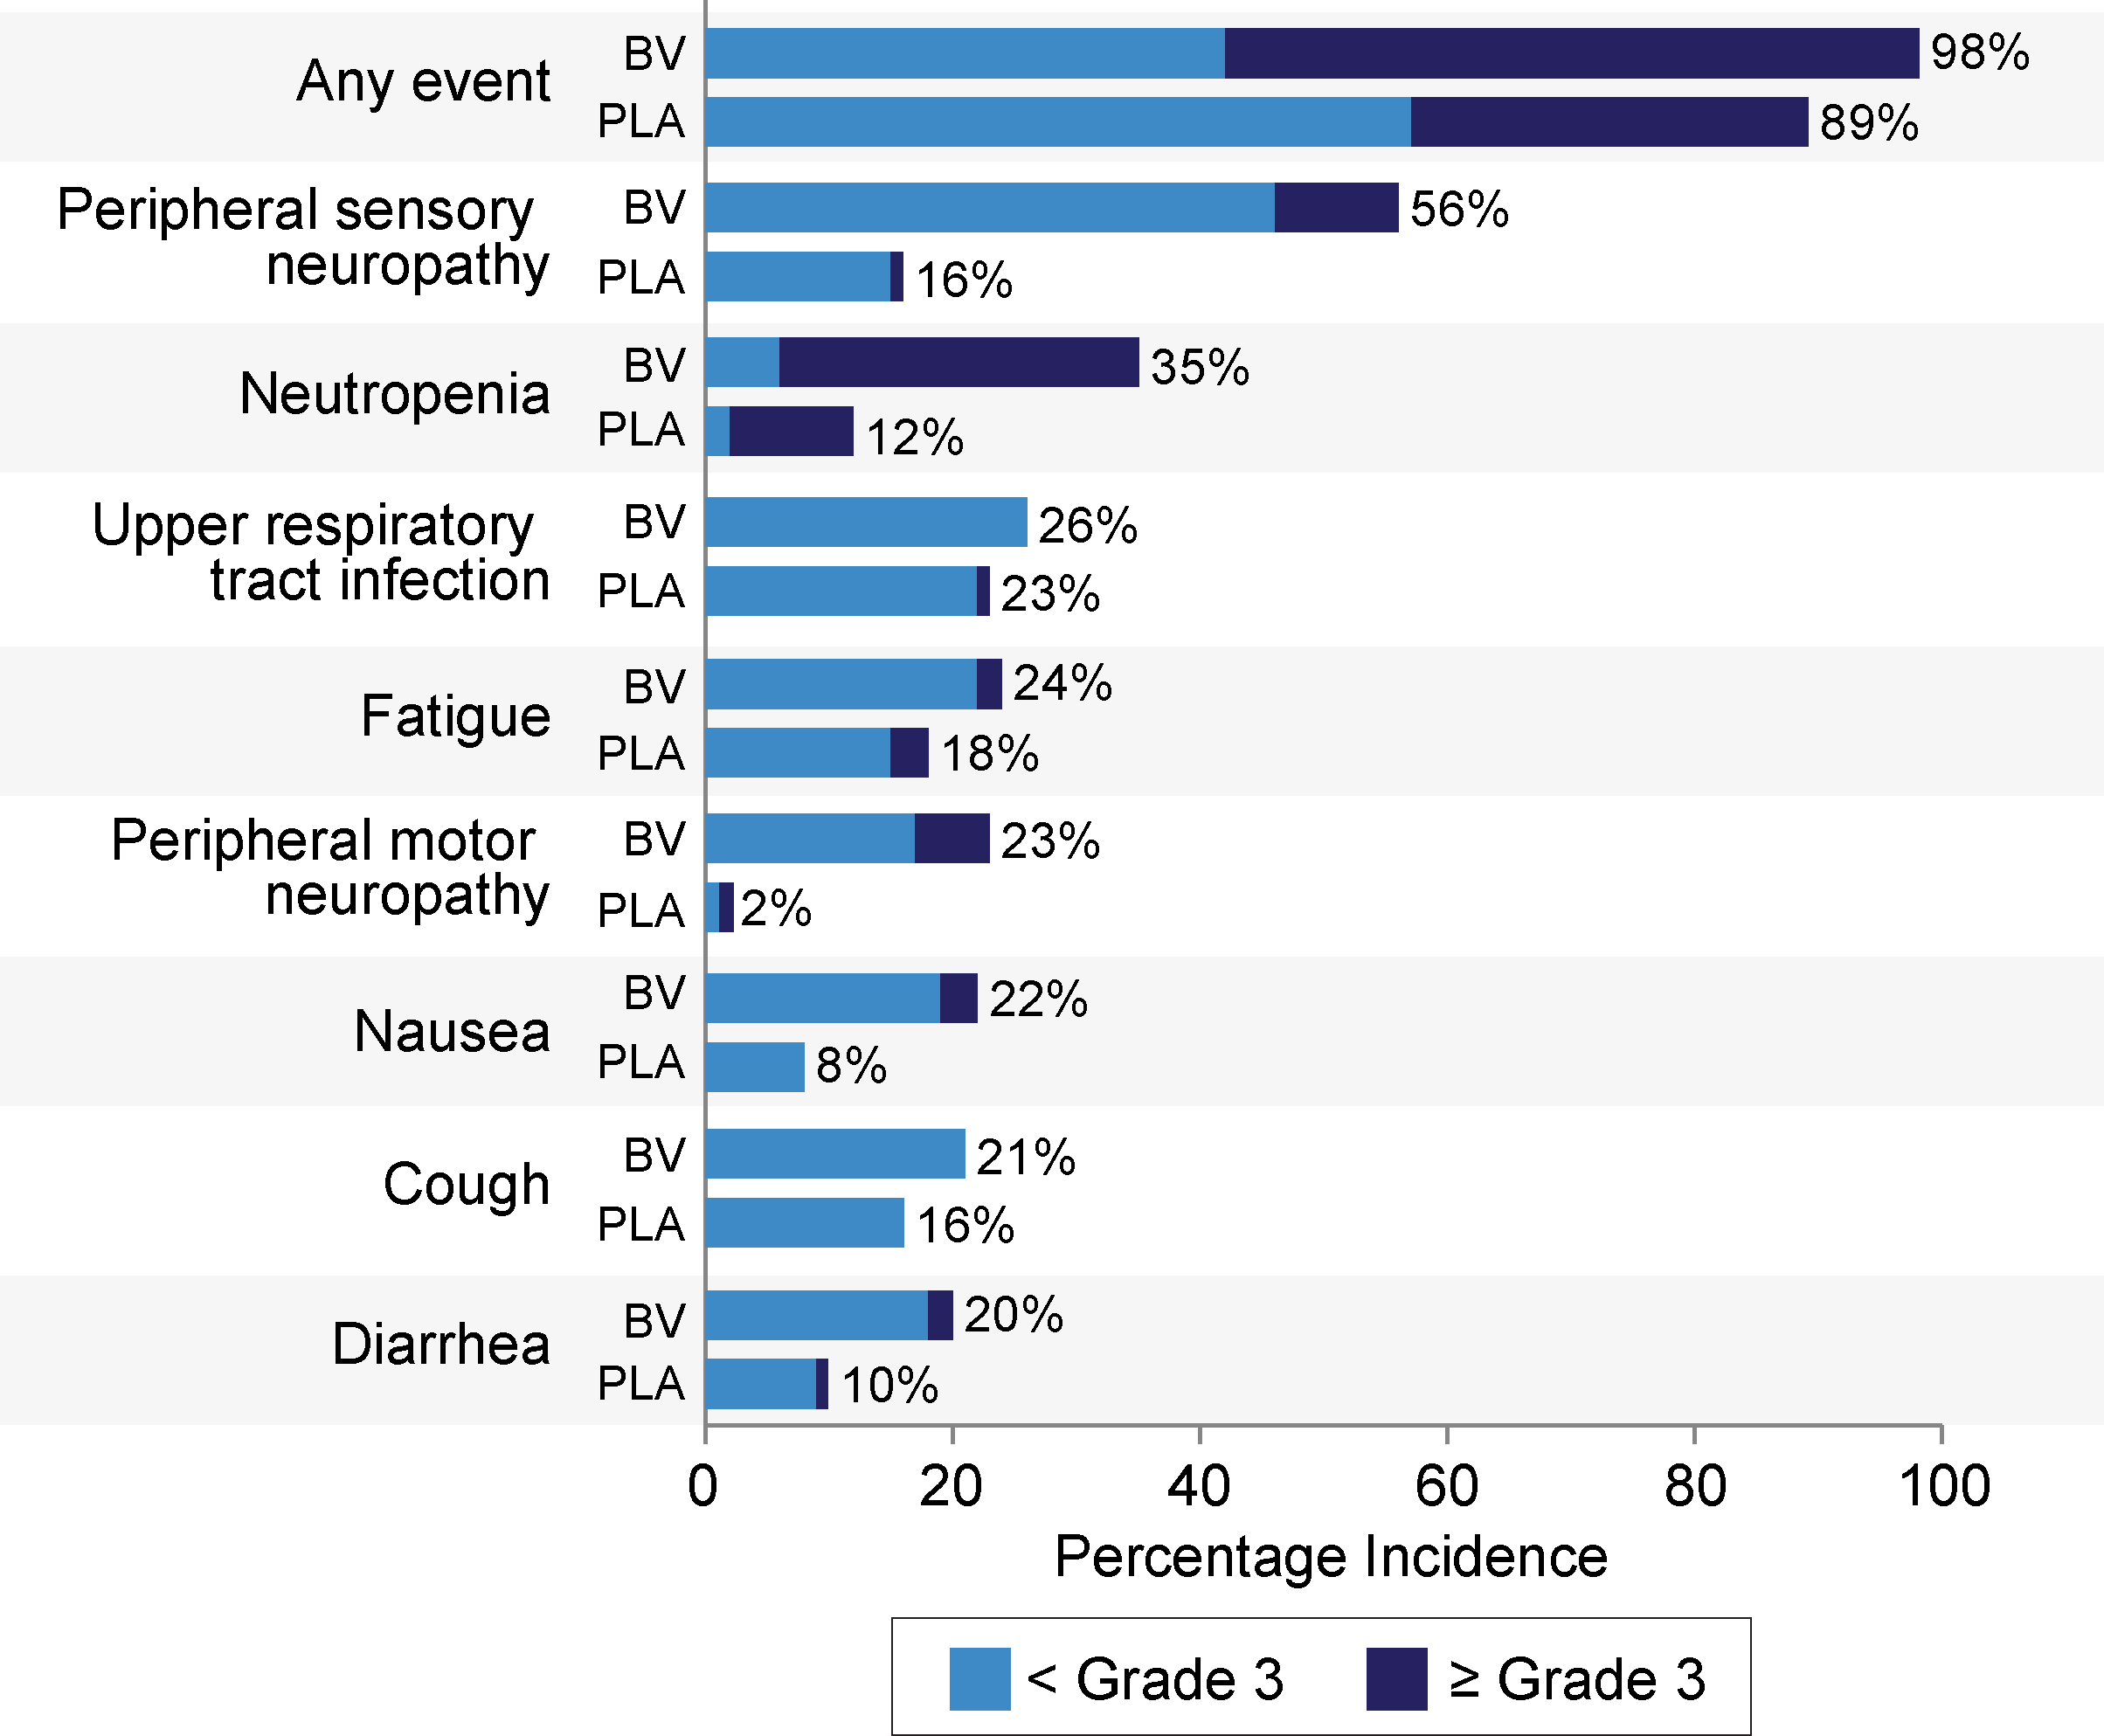
Adverse Events*
Peripheral neuropathy (SMQ analysis)
Any grade: 67% BV; 19% placebo
Grade 3: 13% BV; 1% placebo
No grade 4 events
85% resolution or improvement on BV arm
Median time to resolution or improvement 23.4 weeks on BV arm
Dose modifications due to adverse events
Dose delays: 9% BV, 3% placebo (by dose)
Dose reductions: 32% BV, 3% placebo (by pt)
* Treatment-emergent adverse events regardless of relationship to therapy; incidence ≥20% on BV arm
Moskowitz CH, et al. Blood. 2014;124: Abstract 673.

Slide 15
Deaths
 | BV | Placebo
 | N = 167 n (%) | N = 160 n (%)
Total | 28 (17) | 25 (16)
Related to disease | 18 (11) | 17 (11)
Not related to disease | 9 (5) | 7 (4)
Disease relationship unknown | 1 (1) | 1 (1)
Prior to PD per investigator | 5 (3) | 3 (2)
One death within 30 days of BV treatment:
Treatment-related acute respiratory distress syndrome (ARDS) associated with pneumonitis
One death at study day 40 (BV treatment arm):
ARDS following an episode of treatment-related acute pancreatitis, which had resolved at the time of death
Moskowitz CH, et al. Blood. 2014;124: Abstract 673.

Slide 16
Conclusions
Early consolidation post-ASCT with BV demonstrated improved PFS per IRF in HL patients with risk factors for relapse or progression (HR = 0.57, P = .001)
PFS benefit was sustained, with 2-year PFS rates per investigator of 65% and 45% on the BV and placebo arms, respectively
Consistent benefit was observed across subgroups
Interim analysis of overall survival did not show a significant difference between treatment arms (P =.62)
Analysis limited by small number of events and the large number of patients on the placebo arm crossing over to BV after progression
More patients on the placebo arm received subsequent anti-tumor therapy and/or allogeneic stem cell transplant
Consolidation therapy was generally well tolerated
Peripheral sensory neuropathy and neutropenia were common, and were manageable with dose reductions or delays
Two deaths occurred within 40 days of dosing with BV
BV consolidation therapy is an important therapeutic option for HL patients undergoing ASCT to reduce the risk of relapse or progression
Moskowitz CH, et al. Blood. 2014;124: Abstract 673.

